Slide 1

Flower Image
Classification using CNN
Teaching a convolutional neural network to recognise five flower species from 3,670 photos
Deep Learning | TensorFlow and Keras
Vandana Illipilla · November 2026

Slide 2
From pixels to species
A compact CNN learns visual features directly from 3,670 labelled photographs.
3,670 labelled
images
Three-block
CNN
Held-out
validation
Five species
classes
Prepare → build → train & validate → compare loading methods

Slide 3
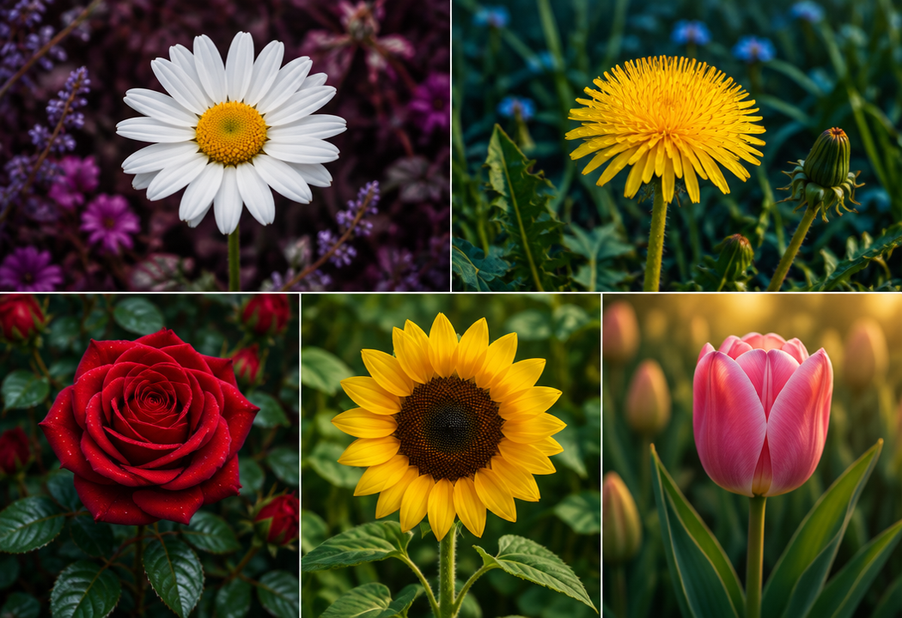
The dataset
3,670
JPEG images
5
labelled classes
180×180
training pixels
Class counts • daisy 633 • dandelion 898 • rose 641 • sunflower 699 • tulip 799

Slide 4
A reproducible, GPU-ready data pipeline
Download
& extract
80 / 20 split
2,936 / 734
Resize
180 × 180 × 3
Batch
32 · labels 0–4
Rescale
1 / 255
Cache + prefetch
AUTOTUNE
Deterministic split seed 123 · batch size 32 · cached tensors keep the accelerator fed

Slide 5
Data pipeline overview
Download &
extract
80/20 split
2,936 / 734
Resize
180×180×3
Batch 32
labels 0–4
Rescale
1 / 255
Cache + prefetch
AUTOTUNE
Deterministic split with a fixed seed • 92 training steps per epoch • caching removes repeated decode overhead

Slide 6
Three ways to load the same data
01
02
03
Keras directory loader
Custom tf.data
TensorFlow Datasets
Epochs 1–3
Epochs 4–6
Prepared
Simple split, resize and batching
list_files, shuffle, decode_jpeg
tfds.load test split; not trained

Slide 7
Three-block CNN architecture
Input
180×180×3
Conv + Pool
89×89×32
Conv + Pool
43×43×32
Conv + Pool
20×20×32
Flatten
12,800
Dense ReLU
128
Logits
5
Each convolution: 32 filters • 3×3 kernel • ReLU Each block: 2×2 max pooling

Slide 8
The dense layer dominates the parameter budget
Layer
Output shape
Parameters
Conv2D + Pool 1
89 × 89 × 32
896
1,658,565
Conv2D + Pool 2
43 × 43 × 32
9,248
total trainable parameters
~99% in Dense 128
Conv2D + Pool 3
20 × 20 × 32
9,248
Flatten
12,800
0
Dense 128
128
1,638,528
Dense logits
5
645

Slide 9

Training setup
Adam optimizer
Sparse categorical cross-entropy
Accuracy metric
6 epochs • 92 steps each
734 validation images
Tesla T4 + XLA • ~2 sec/epoch cached

Slide 10
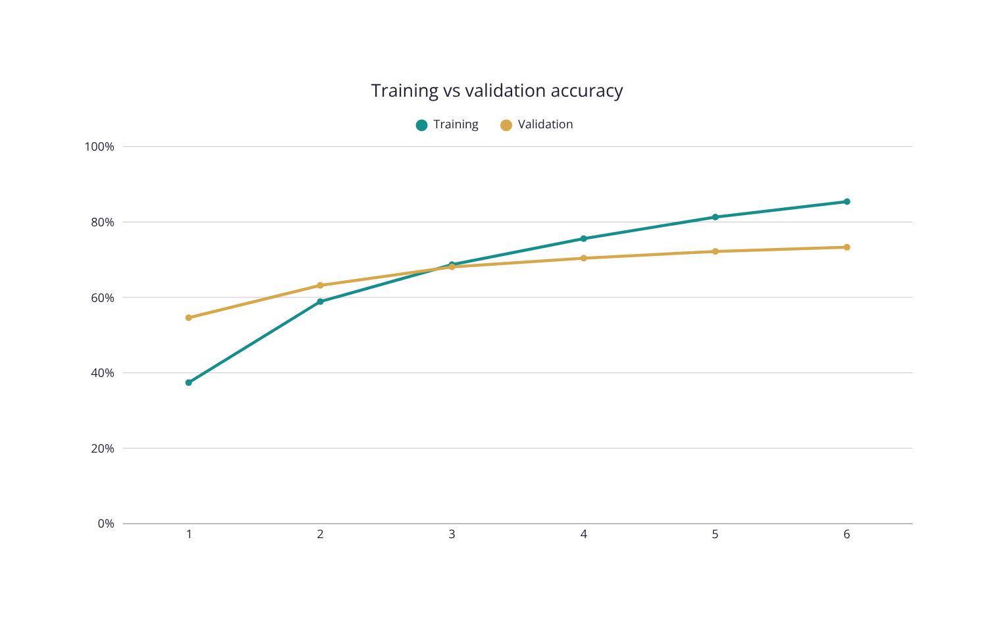
Accuracy keeps climbing — but the gap widens
73.3%
validation accuracy at epoch 6

Slide 11
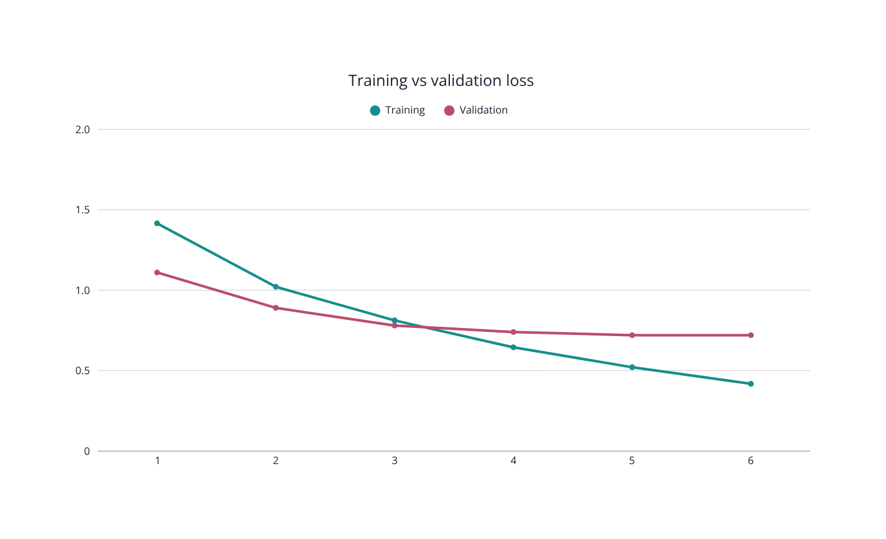
Validation loss flattens first
Training loss continues down.
Validation loss plateaus near 0.72 — an early overfitting signal.

Slide 12
Six epochs established a strong baseline
73.3%
~0.72
validation accuracy
validation loss
1.66M
2,936 / 734
trainable parameters
train / validation images

Slide 13
What worked—and what to watch
INSIGHTS
WATCH-OUTS
Steady learning with a simple CNN
Caching + prefetching kept the T4 utilized
Weights carried forward across both pipelines
~12-point train–validation gap by epoch 6
Validation loss plateaued while training fell
TFDS test split is prepared, not evaluated

Slide 14
From baseline to robust classifier
01
Augment
flips · rotations · zooms
02
Regularize
dropout + early stopping
03
Transfer
MobileNetV2 / EfficientNet
04
Evaluate
test split + confusion matrix
05
Diagnose
per-class error analysis

Slide 15
A credible baseline—and a clear path forward
73.3%
Built a three-block CNN with ~1.66M parameters in TensorFlow/Keras.
Trained on 2,936 images across five flower classes.
Augmentation, regularization and transfer learning are the next leverage points.
validation accuracy after six epochs

Slide 16

Thank you!
Vandana Illipilla
Deep Learning Project | TensorFlow and Keras

